Slide 1
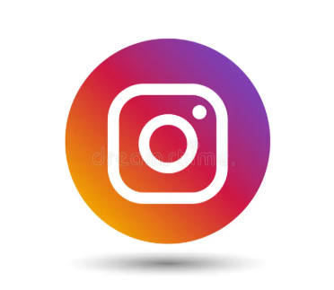
SOCIAL MEDIA ANALYSIS
PRESENTED BY
SAURABH SHARMA
(SQL Based Social Media Project)

Slide 2
Project Overview
• This project analyzes Instagram user data to support marketing decisions at Meta.
• The analysis focuses on user activity, engagement, and interaction patterns.
• SQL is used to study posts, likes, comments, followers, and hashtags.
• The goal is to improve user engagement, retention, and acquisition through data-driven insights.

Slide 3
AGENDA
1.Problem statement
2.Data Description
3.Data Schema
4.Data Analysis & Key Findings
5.Recommendations for Inactive Users
6.Content and Platform Optimization Strategy
7.Business Recommendation
8.Conclusion & Key Takeaways

Slide 4
PROBLEM STATEMENT
You are hired as a data analyst at Meta to collaborate with the Marketing team.
The Marketing team wants to leverage Instagram’s user data to develop targeted
marketing strategies that will increase user engagement, retention, and acquisition.
The objective of this project is to analyze user behavior and engagement patterns
and provide actionable insights and recommendations to support data-driven
marketing decisions.

Slide 5
DATA DESCRIPTION
Users:
id – Unique identifier for each user.
username – Username of the user.
created_at – Date and time when the user account was created.
Photos:
id – Unique identifier for each photo.
image_url – URL of the uploaded photo.
user_id – ID of the user who uploaded the photo.
created_dat – Date and time when the photo was uploaded.
Comments:
id: Unique identifier of each comment made to any photo posted.
comment_text: Comment made on the post.
user_id: id of the user who made the comment.
photo_id: id of the photo where the comment is made.
created_at: Timestamp of when the comment is made.

Slide 6
DATA DESCRIPTION
Likes:
user_id – ID of the user who liked the photo.
photo_id – ID of the photo that was liked.
created_at – Date and time when the like was made.
Follows:
follower_id – ID of the user who follows another user.
followee_id – ID of the user being followed.
created_at – Date and time when the follow action occurred.
Tags:
id – Unique identifier for each tag.
tag_name – Name of the tag.
Photo_Tags:
photo_id – ID of the photo.
tag_id – ID of the tag.

Slide 7
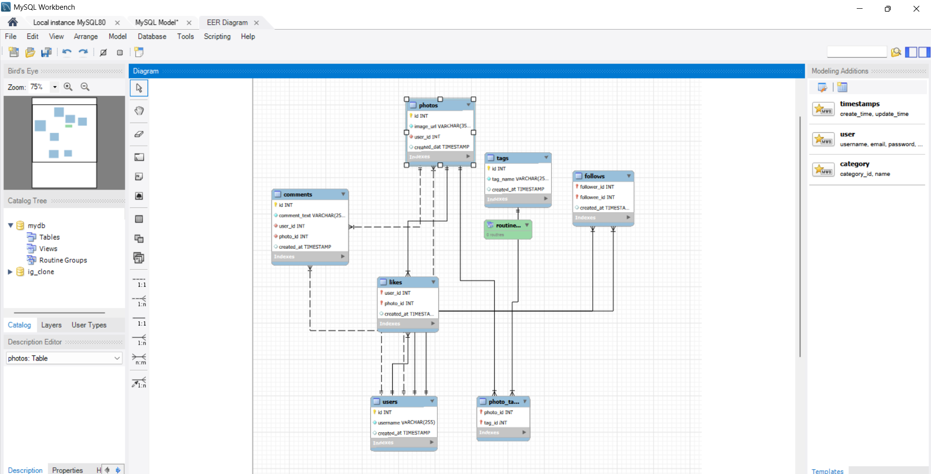
DATABASE SCHEMA

Slide 8
Data Analysis & Key Findings
User Distribution by Activity Level
Top Users by Engagement
High Value Users & Reward Strategy
Influencer Marketing Candidates
User Segmentation for Targeted Marketing
Posting Consistency vs User Engagement

Slide 9
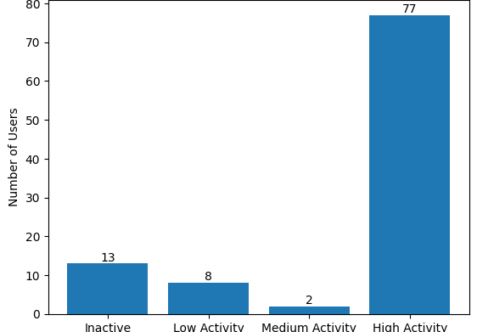
User Distribution by Activity Level
The chart shows that the majority of users (77) fall under the High Activity category,
Indicating strong overall engagement on the platform.
However, there are still ,13 Inactive users and 8 Low Activity users, representing a segment with low participation.
This highlights an opportunity to re-engage inactive and low activity users while continuing to retain and reward highly active users.
Only 2 users fall under Medium Activity, suggesting a clear gap between low and high engagement levels among users.

Slide 10
Top Users by Engagement
• The top 10 users generate very high engagement, ranging from around 150 to 340 interactions.
• Comments contribute more to total engagement than likes across all top users.
• Engagement consistently declines from rank 1 to rank 10, showing a clear performance gap.
• A small group of users contributes disproportionately to overall platform interaction.
• These highly engaged users are ideal candidates for influencer marketing and reward programs.

Slide 11
High Value Users & Reward Strategy
The chart indicates that only a small group of users generates very high total engagement, showing that platform activity is highly concentrated among top users.
Comments contribute more significantly to total engagement than likes, highlighting that meaningful interactions and conversations drive higher user value.
Several users achieve strong engagement even with a moderate number of posts , proving that content quality is more impactful than posting frequency.
A gradual decline in engagement across users reveals a clear distinction between high-value users and average users on the platform.
The reward categories align well with engagement levels, validating that users with higher engagement are correctly identified for premium rewards and retention efforts.

Slide 12
Influencer Marketing Candidates
• The chart shows that most shortlisted users have follower counts clustered between 70–80, indicating strong reach across all influencer candidates.
• Average engagement per post remains consistently high (around 60–70),proving that these users do not just have followers but also active audiences.
• Users like Donald Fritsch, Aurelie71, and Cesar93 stand out with both high followers and high engagement, making them ideal primary influencer choices.
• Some users with slightly lower followers still maintain comparable engagement, suggesting their audience is more responsive and loyal.
• The close alignment between follower bars and engagement bars confirms that these users can deliver both visibility and interaction for marketing campaigns.

Slide 13
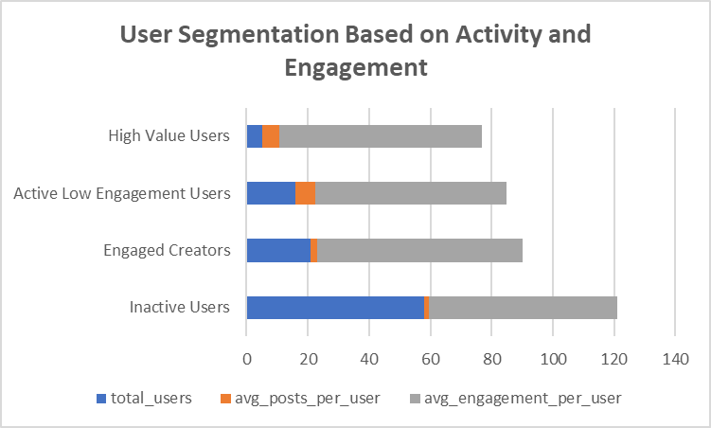
User Segmentation for Targeted Marketing
• The chart shows that the largest portion of users falls under the Inactive Users segment, indicating a significant opportunity for re-engagement strategies.
• Engaged Creators have fewer users compared to inactive users but show the highest average engagement per user, making them critical for content growth.
• Active Low Engagement Users post frequently but generate comparatively lower engagement, suggesting a need for content quality improvement.
• High Value Users represent the smallest segment, yet they maintain strong engagement levels, highlighting their importance for retention and rewards.
• Overall, the segmentation clearly distinguishes users based on behaviour, enabling more targeted and personalized marketing campaigns.

Slide 14
Posting Consistency vs User Engagement
• The chart shows that users with fewer posts, such as Meggie_Doyle and Jaylan_Lakin, achieve very high average engagement per post, indicating strong content quality.
• Users with a higher number of posts do not always have proportionally higher engagement, proving that posting frequency alone does not drive engagement.
• Average engagement per post remains relatively stable across users, highlighting that consistency in quality matters more than volume.
• Some moderately active users outperform highly active users in terms of engagement efficiency.
• Overall, the chart suggests that focusing on content relevance and audience interaction is more effective than increasing posting frequency.

Slide 15
Recommendations For Inactive Users
Inactive users represent the largest segment of the user base, indicating a
significant opportunity for re-engagement. To activate these users, personalized
strategies should be implemented.
• Send personalized notifications based on past activity and interests.
• Introduce limited-time incentives such as bonus visibility or badges.
• Use email or in-app reminders highlighting trending content and creators.
• Encourage low-effort interactions like polls, reactions, or story replies.
• Re-onboard inactive users with feature walkthroughs and content suggestions.

Slide 16
Content and Platform Optimization Strategy
Overall engagement analysis indicates that content quality and meaningful
interactions drive user engagement more than posting frequency alone. The
platform should prioritize content relevance, conversational interactions,
and personalized recommendations.
Key focus areas include:
• Promoting content that generates higher comments and discussions.
• Supporting engaged creators through visibility and rewards.
• Encouraging quality over quantity in content creation.
• Leveraging user segmentation to deliver targeted content and ads.
• Continuously optimizing strategies using data-driven insights.

Slide 17
Business Recommendations
• Reward high-value users to improve retention and loyalty.
• Collaborate with highly engaged users for influencer marketing.
• Focus on content quality over posting frequency.
• Re-engage inactive users through personalized campaigns.
• Use user segmentation for targeted and effective marketing strategies.

Slide 18
Conclusion & Key Takeaways
The analysis of Instagram user data shows that engagement is driven by a
small group of high-value and engaged users. Comments play a more important role than likes in driving meaningful interactions.
Posting frequency alone does not guarantee high engagement, highlighting
the importance of content quality. User segmentation enables targeted
marketing strategies that improve engagement, retention, and acquisition.
Overall, data-driven insights can help optimize influencer marketing,
content strategy, and user retention initiatives.

Slide 19
THANK YOU

